Slide 1
Basic Leadership Skills

Slide 2

Contents
Introduction to leadership skills
Career skills for a leader
People skills for a leader
Technical skills for a leader
Values and behaviors
Communication and conflict resolution skills
Leadership initiatives for achieving cultural diversity
Leadership development and succession
Case studies

Slide 3
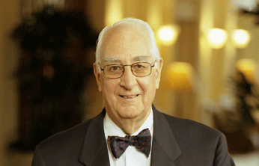
Max DePree
“The first responsibility of a leader is to define reality. The last is to say thank you. In between the two, the leader must become a servant and a debtor. That sums up the progress of an artful leader”

Slide 4

The skills needed . . .
1
Knowing the resources of the group
2
Communicating
3
Planning
4
Controlling group performance
5
Evaluating
6
Setting examples
7
Sharing leadership
8
Counselling
9
Effective teaching
Let us look each one in detail

Slide 5

Knowing the resources of the group
Easy to change
Difficult to change
Knowledge
Skills
Attitude
Character
When the leader uses the knowledge and skills of group participants to get a job done, the participants gain experience and improve skills. They also develop a positive attitude toward using a skill
Leader

Slide 6


The art of communication for a leader
  Getting information
When you look at this, it is very clearly understood there is no attention to listening
Pay attention and listen carefully
Make notes and sketches
Ask questions and repeat your understanding of what was said

Slide 7
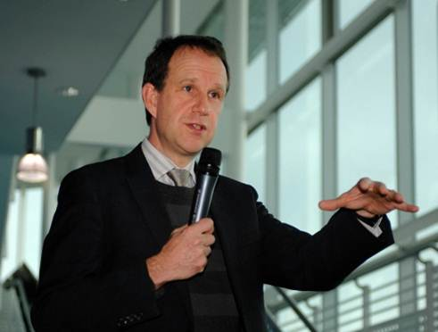

The art of communication for a leader
  Giving information
Be sure others are listening before you speak
Speak slowly and clearly
Draw diagrams, if needed
Have the listeners repeat their understanding of what was said
Encourage questions

Slide 8


Planning
Planning is an important part of every leader
Consider the task and objectives. What do you want to accomplish?
Consider the resources—equipment, knowledge, skills, and attitudes
Consider the alternatives. Brainstorm.
Reach a decision, evaluating each option
Write the plan down and review
Execute the plan
Evaluate the plan

Slide 9

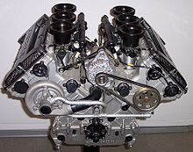

Controlling group performance
Leader
  A leader influences the performance of the group and individual participants through his or her actions. Why is control needed?
Consider the following example
  Engine
  Throttle
Does the engine run without a throttle?
Throttle keeps engine running itself into the ground

Slide 10

Controlling group performance
  Similarly, a group works together best when everybody is headed in the same direction
  If a plan is to be properly carried out, someone must lead the effort
  Control is a function that the group assigns to the leader to get the job done
  Control happens as a result of recognizing the difference between where the group is and where the group is going
  The leader is responsible for developing a plan to help the group get to its goal

Slide 11


Evaluating – the leader activities
  Evaluating helps measure the performance of a group in getting a job done and working together. It suggests ways in which the group can improve its performance
Getting the job done
Was the job done?
Was the job done right?
Was the job done on time?
Were relationships between group participants helped or hurt?
Was participation equally distributed among group participants?
Did the group enjoy the activity?
Did the group handle conflicts well?
Keeping group together

Slide 12

Setting the example
  Setting the example is probably the most important
  leadership skill
  It is the most effective way to show others the proper way to conduct themselves, and is even more effective than verbal communication
  One way to think about setting the example is to imagine
  yourself as part of a group and think about how you
  would like your leader to act

Slide 13

Sharing leadership
“For a good leader
When the work is done, his aim fulfilled, they will say, ‘We did this ourselves’
The Exploring leader wants to give team participants the skills he or she possesses, not to use those skills in ways that keep the team weak or dependent
He or she offers leadership opportunities to team participants and teaches them the skills they need

Slide 14
Counselling
Counselling is important
1
2
3
To help an Explorer reach his or her potential
To help people solve problems
To encourage or reassure
Counselling can be effective when a person is
4
5
6
Confused—
he or she doesn’t have enough information or has too much information
Undecided—he or she can’t make a decision
Locked in—he or she doesn’t know any alternatives

Slide 15

How do you counsell?
First, try to understand the situation. Listen carefully. Summarize
Check the facts. Paraphrase to make sure you understand
Second, list as many options as possible
Third, list the dis-advantages of the options
Fourth, list the advantages of the options
Finally, let the person decide on a solution. The counselor’s role is to give encouragement and information, not advice

Slide 16




Effective teaching
Effective teaching is a process to increase the knowledge, skills, and attitudes of the group and its participants. The focus is on learning, not teaching. For teaching to be effective, learning must take place
Providing a discovery experience that helps the learner understand the need for the skill
Demonstrating or explaining the skill
Allowing the learner to practice the skill
Choosing the learning objectives
Evaluating the process

Slide 17
Contents
Introduction to leadership skills
Career skills for a leader
People skills for a leader
Technical skills for a leader
Values and behaviors
Communication and conflict resolution skills
Leadership initiatives for achieving cultural diversity
Leadership development and succession
Case studies

Slide 18
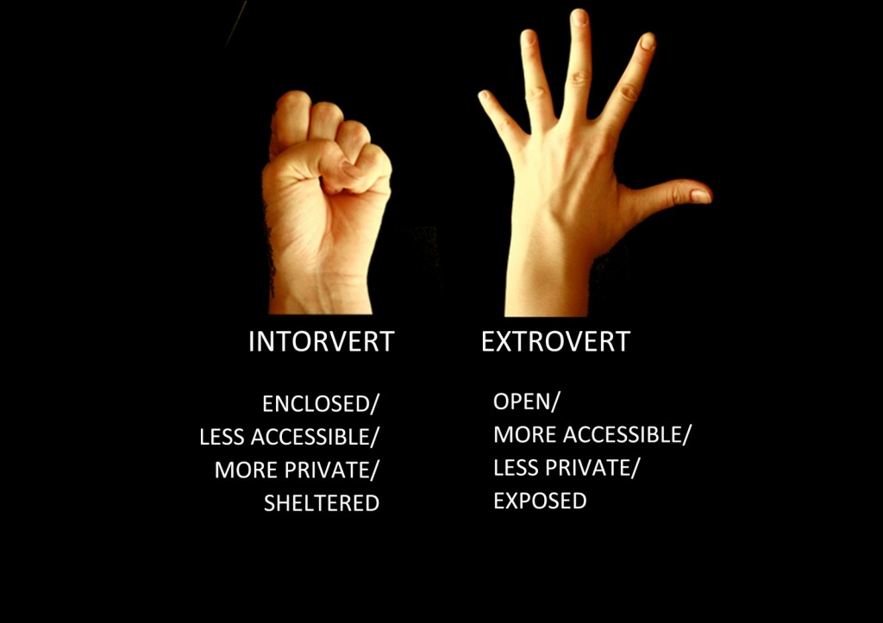
Understanding others
Do not try to be someone else
Do not try to change the other person
Be patient
Be aware
If you are an introvert, then you are not suddenly going to transform yourself into an extrovert who is the life and soul of the party. Under stress, people often do resort to a second style of operation
Find the right situation in which to work
Build the team

Slide 19

Understanding others
Do not try to be someone else
Do not try to change the other person
Be patient
Hey! Paul Come . . On . . What are you up to?
Tom please don't make me to accept this. Sorry!
Be aware
Understand how the other person’s style differs from yours. These differences are positive. Together, you are likely to be able to achieve more than if you operate independently
Find the right situation in which to work
Build the team

Slide 20
Understanding others
Do not try to be someone else
Do not try to change the other person
Be patient
If you are highly task-focused, it can be frustrating if some one else never talks about critical tasks in hand. Instead, this person talks about people the whole time
Be aware
Find the right situation in which to work
Build the team

Slide 21

Understanding others
Do not try to be someone else
Most of us stumble into personal and professional relationships. We know how long it takes to build personal relationships. We have little time to build professional relationships. We need to understand other people’s styles fast so that we can influence them positively and quickly
Do not try to change the other person
Be patient
Be aware
Find the right situation in which to work
Build the team

Slide 22
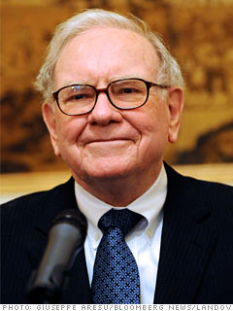

Understanding others
Do not try to be someone else
Warren Buffet remarked that, “when a great manager joins a lousy company, it is normally the reputation of the company that remains intact” .
Do not try to change the other person
Be patient
Be aware
The same is true of work styles: You will not change the style of the organization in which you work. You need to find a way of living with the style of your organization, or you need a new organization
Find the right situation in which to work
Build the team

Slide 23

Understanding others
Strong teams are diverse. Diversity does not mean regulatory diversity and having token minorities decorating the cover of annual report. It means the subtler diversity of building a team with complementary styles, skills and perspectives
Do not try to be someone else
Do not try to change the other person
Be patient
Be aware
Find the right situation in which to work
Build the team

Slide 24




Leadership success matrix
Dreamers
Leaders
High
Ambition
Low
Laggards
Sleepers
Low
High
Ability

Slide 25

Finding the right place at right time
Is this an organization with prospects?
A declining organization has fewer opportunities than a growing one. Are those prospects real and sustainable? How does the organization compare to its peer group

Slide 26

Finding the right place at right time
Will I enjoy the work?
You only excel at what you enjoy. And you will spend a large of your waking hours at work. So if you are working just for the money, you will find it tough to sustain the enthusiasm and stamina required in the road to leadership

Slide 27
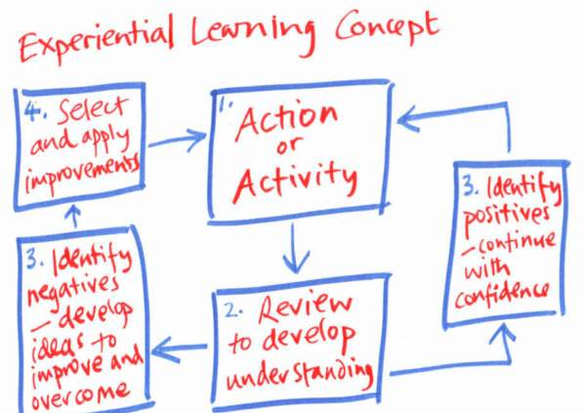
Finding the right place at right time
What will I learn?
You will learn some technical skills. But you will also need to learn people skills and leadership skills. Are you learning the right mix of skills to sustain the leadership journey, or are you simply reinforcing technical skills, which will keep you at your current level

Slide 28
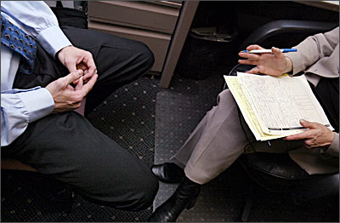
Finding the right place at right time
How will this experience look on my CV?
Will other employers value the skills and experience I am gaining, or am I locking myself into my current employer by acquiring a very narrow set of skills and experience

Slide 29

Assessing your next move
Growing organization have more opportunities than static ones
Do I have the right skills/cultural fit? What happened to the cohort of five years ago?
Is this organization likely to be a winner? why?
•
•
•
•
•
•
•
Can I see myself enjoying work at this new organization? Do I like the people and its purpose
Will it grow and create opportunities for me as it grows?
Will I be learning skills that will be helpful to me longer-term? Do the skills give me options or do they tie me into one specific career journey
Am I likely to succeed here?

Slide 30
Contents
Introduction to leadership skills
Career skills for a leader
People skills for a leader
Technical skills for a leader
Values and behaviors
Communication and conflict resolution skills
Leadership initiatives for achieving cultural diversity
Leadership development and succession
Case studies

Slide 31

Principles of effective delegation
Ensuring clarity over the task and the eventful success criteria. Make the team summarize back to you what they think the task and out comes are meant to be. Do not assume they have understood anything until they say it back to you
Ensuring Clarity
Ensure enough skills and resources
Be clear
Be available to help
Delegate projects
Show faith

Slide 32

Principles of effective delegation
Ensure people have enough skills and resources to complete the job; do not delegate too much too soon
Ensuring Clarity
Ensure enough skills and resources
Be clear
Be available to help
Delegate projects
Show faith

Slide 33

Principles of effective delegation
Be clear about how you want to work together (progress reports). Discuss concerns before you stare
Ensuring Clarity
Ensure enough skills and resources
Be clear
Be available to help
Delegate projects
Show faith

Slide 34

Principles of effective delegation
Be available to help, but do not interfere all the time when they ask for help, ensure that they suggest solutions so that they always learn
Ensuring Clarity
Ensure enough skills and resources
Be clear
Be available to help
Delegate projects
Show faith

Slide 35

Principles of effective delegation
Delegate meaningful projects, not just administrivia. Stretch people and they will rise to the challenge. Giving away mundane jobs only demotivates people
Ensuring Clarity
Ensure enough skills and resources
Be clear
Be available to help
Delegate projects
Show faith

Slide 36

Principles of effective delegation
Show faith and trust in the team. Praise successes, and do not undermine team
Ensuring Clarity
Ensure enough skills and resources
Be clear
Be available to help
Delegate projects
Show faith

Slide 37


Effective delegation chart
Others can do this
Only I can do this
Very important
Delegate- supervise and support closely
Take the lead- involve others so they can learn and develop
Less important
Delegate- make sure you are delegating more, than just the rubbish
Are you sure? Could be a development opportunity for someone

Slide 38
Maslow’s hierarchy of needs- The unauthorized, revisionist, leadership vision
Greed
Self-actualization
Risk and idleness
Leaving a legacy
Esteem recognition
Love belonging/earning
Safety; Job security
Physic logical
Pay and conditions
Fear

Slide 39
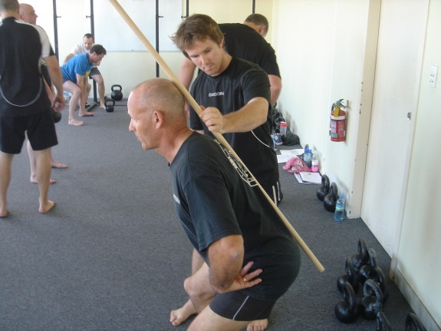
The art of coaching
The art of coaching is about helping people discover their own potential and resolve their own issues. It is not about telling them what to do or solving all their problems for them
Instructing, telling and solving problems
Giving advice and guidance, and suggesting ideas
Giving feedback to people
Asking questions to understand the context and looking for options
Listening, summarizing and reflecting

Slide 40


Coaching structure
Understand the context
Agree the goal/purpose of the session:
Why is this important to you now?
What is the situation?
How do the other people see the situation?
How do you know that?
What do you/others feel about the situation?
What are the potential consequences of this?
What do you want to focus on / achieve/ review today?

Slide 41
Coaching structure
Create and evaluate options:
Have you seen anything similar before?
What happened?
What choices do you have? What do others want?
What are the risks and benefits of each course of action?

Slide 42

Coaching structure
Conclude
So tell me what you are going to do next?
Will any thing prevent you doing this?
Do you need any help or support?

Slide 43
Contents
Introduction to leadership skills
Career skills for a leader
People skills for a leader
Technical skills for a leader
Values and behaviors
Communication and conflict resolution skills
Leadership initiatives for achieving cultural diversity
Leadership development and succession
Case studies

Slide 44

Writing
Write for the reader:
Who are you writing for and why? Ask yourself why the reader should want to read your document and what you expect the reader to do as a result of it

Slide 45
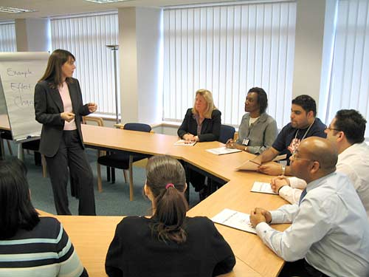
Writing
Tell a story:
What is the one headline you want the reader to remember. Construct a storyline to support the reader to remember. Construct a storyline to support the headline.
What is the message I need to get across?
What is the minimum amount of information required to support the message?

Slide 46

Writing
Keep it simple
Use short words and short sentences. Remember the ditty;
“when writing, keep it short. A dozen words at most per thought”

Slide 47



Writing
The passive and impersonal do not make a document look business like. They make the document boring. Make it readable instead, if you want if to be read
Make it actIve

Slide 48

Writing
Support assertions with facts
If something is important, urgent or strategic, explain why it is important, urgent or strategic to your reader.

Slide 49

Listening
Paraphrasing: When some one talks, try paraphrasing back to them what they said. If you get it right, the other person will be delighted that you were listening so well. If you get it wrong, you will quickly avoid any future misunderstandings

Slide 50

Listening
Asking open questions: The more open the question, the more people talk. A closed question gets a yes or no answer. It gives little information and often leads to conflict. Open question often start
‘How would you……….’,
‘Why did they’……….? or
‘what would you do it……….?’
closed questions often starts
‘Do you agree……?’ or
‘Shall we…..?’

Slide 51

Listening
Debriefing: After any significant meeting, spend a few minutes debriefing with a colleague. You will both have heard and seen different things. Together, you will get more intelligence and feed back than if you try scribbling notes furiously during the meeting

Slide 52
Presenting style
The focus of E’s
Energy
Expertise
Enjoyment
Enthusiasm
Excitement

Slide 53


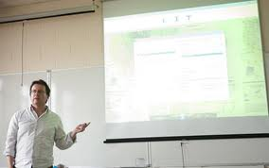


Presenting style: tips
Throw away the script: Memorize your opening to make a good start. Memorize your conclusion to make a good finish
Avoid complicated slide presentations:
If you have slides, the principle is to have stupid slides but a smart presenter. The slide might have three or four key words to help the audience anchor where you are, you provide the commentary
Stand on the front of your feet: Weight on the back of the foot encourages slouching and down energy
Engage the audience: Look individuals in the eye, rather than gazing into the middle distance. Do not stare at one person the whole time

Slide 54
Problem solving process and techniques
Be clear who has the problem and the consequences of fixing it
Under-stand the problem

Slide 55
Problem solving process and techniques
Some people advocate complete brainstorming. But if you have really understood the problem, the answer is often not far away
Create hypotheses

Slide 56
Problem solving process and techniques
Don’t waste time evaluating every option. Let the group pick the two or three they most want to work on
Evaluate and select the best hypothesis

Slide 57
Problem solving process and techniques
If the previous three steps have been completed well, this is the easiest step. The drill down may reveal further, lesser problems, which can be solved with the some four-step process
Drill down the action planning

Slide 58
Decision making
Leaders always have to make decisions in a fog of uncertainty. In practice, they need ways to make the decision-making process easier
  Habit
  Pitch a decision in a familiar frame work as a low-risk continuation or extension of how things have been done before
  Credibility
  Line up credible supporters to back your idea
  Anchoring
  The leader needs to get in early and set the terms of the debate correctly from the start

Slide 59
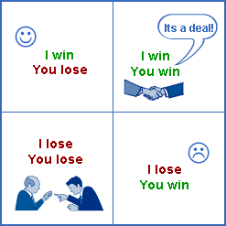
Negotiation process
Agree the problem
What is the common opportunity or challenge we can will each other with?
Preview the benefits
What are the positive outcomes for each of us? What are our interests, not just our positions?
Suggest the idea
Do not get locked into a single-point solution that invites a yes or no response. Create room for manoeuvre
Explain how it works
Work this together so that both sides own the solution:
If both sides feel they own the solution, both sides way feel committed to it.

Slide 60
Negotiation process
Pre-employment objections
Work together to identify the potential pit falls and how you will overcome them.
Reinforce the benefits
Keep your eyes on the prize. This is why you are working together.
Close
Work out exactly what the next steps and responsibilities one, and then follow up.

Slide 61
Contents
Introduction to leadership skills
Career skills for a leader
People skills for a leader
Technical skills for a leader
Values and behaviors
Communication and conflict resolution skills
Leadership initiatives for achieving cultural diversity
Leadership development and succession
Case studies

Slide 62




Working to Win
Play to your strengths:
Know what you are good at and in what context (occupation, company and project)
Visualize success:
This is important before big, stressful events. Walk through each step of the event seeing what a successful outcome looks like, feel like, smells like and sounds like
Think like a winner:
Remember all the times you have done great things. Let your self get back into that frame of mind.
Create a team that compensates for your weaknesses:
If you are not good at accounting, rest assured there are thousands of accountants out these to help

Slide 63
Learning to be lucky – The 4 Ps
P
P
P
P
Persistence
Positive Outlook
Practice
Preparation
The more you practice, the luckier you get
The difference between failure and success is giving up
If you do not know what you are looking for, you will not find it. Know what you want, hunt it persistently
Look for solutions, not problems. Look for action, not analysis. Be confident in yourself; If you are not enthusiastic, no one else will be

Slide 64
Positive leadership- Asking the right questions
Leader mindset
Follower mindset
What are some possible solutions/options/ways forward?
What went wrong?
What can I do now to regain control and build momentum?
Why have I been put in this position?
Whose support do I need and how will I get it?
Who messed up? Who is going to put this right?
What can I learn from this?
How do I avoid blame?

Slide 65
The art of buying time
Agree the goal of the idea
What is the problem this idea solves? For whom?
What are the benefits if doing this? For whom?
Understand the context:
What are the time frames?
What support and resources will be available?
Why are we looking at this now?
How does this fit with our other priorities?
Create and evaluate options
How else can this be achieved?
What are the obstacles to success?
Conclude
What are the next steps?

Slide 66
Contents
Introduction to leadership skills
Career skills for a leader
People skills for a leader
Technical skills for a leader
Values and behaviors
Communication and conflict resolution skills
Leadership initiatives for achieving cultural diversity
Leadership development and succession
Case studies

Slide 67
Suggestion for inspirational speaking and writing
1
Be credible.
2
Gear your message to the listener.
3
Sell group members on the benefit of your suggestions.
4
Use heavy-impact and emotion-provoking word.
5
Use anecdotes and metaphors to communicate meaning.
6
Back up conclusions with data.
7
Minimize language errors, junk words, and vocalized pauses
8
Write crisp, clear memos, letters and reports, including a front-loaded message.

Slide 68
Six basic principle of persuasion
1
LINKING
2
RECIPROCITY
3
SOCIAL PROOF
4
CONSISTENCY
5
AUTHORITY
6
SCARCITY

Slide 69


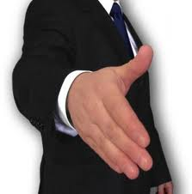
Non verbal communication
Non verbal communication is important because leadership involve emotion, which words alone cannot communicate convincingly. A major component of the emotional impact of a message is communicated nonverbally. A self-confident leader not only speaks and writes with assurance but also projects confidence through body position, gestures and manner of speech.

Slide 70

Overcoming cross- cultural communication barriers
Be sensitive to the fact that cross-cultural communication barriers exists.
Challenge your cultural assumptions.
Show respect for all workers.
Use straight forward language.
Look for signs of misunderstanding when your language is not the listener's native language.
When the situation is appropriate, speak in the language of people from another culture.
Observe cross-cultural difference in etiquette.
Do not be diverted by style, accent, or grammar.
Be sensitive to differences in nonverbal communication.
Be attentive to individual differences in appearance.

Slide 71
Conflict management styles
1
2
3
4
Competitive style
Sharing style
Collaborative style
Avoidant style

Slide 72
Resolving conflict
Much of the time a leader invests in conflict resolution is geared toward assisting others resolve their conflict.
This approach is preferable to inviting each side to speak with the manage or leader alone, because then each side might attempt to convince the manager that he or she is right.
A high-level managerial skill is to help two or more group member resolve conflict between or among them.
The most useful approach is to get the parties is conflict in confrontation and problem solving.
Check for example in next slides

Slide 73



Resolving conflict
I have brought you two together to see if you can overcome the problems you have about sharing the workload during a period in which one of you is overloaded.
I would be glad to help Stephanie if she ever agreed to help me. If she has any downtime, she runs to the break room so she can chat on her cell phone.
Josh
I am glad you did. Josh never wants to help me, even I am drowning in customer requests.
Stephanie
Leader

Slide 74
Resolving conflict
Stephanie
Look who’s talking. I have seen you napping in your SUV when you have downtime.
I know that the name “Josh” is related to joking around, but our Josh has a warm heart. I am open to starting with a fresh state. May be Josh can ask me politely the next time he needs helps.
Both of you are antagonistic toward each other, and you look for little faults to pick.
Josh
Actually, Stephanie's not to bad. And I know she can perform well when she wants to. Next time. I see her needing help, I will pitch in.
Leader
Conflict specialists Patrick S. Nugent believes that being able to intervene in the conflicts of group members is a management skill that grows in importance.

Slide 75
Negotiating and bargaining
Following are several negotiation techniques leaders may need to have at their appraisal.
_{D}
_{C}
A
Begin with a plausible demand or offer.
_{B}
B
Focus on interests, not position.
C
Search for the value in difference between the two sides.
D
Be sensitive to international differences in negotiating style.
_{A}

Slide 76
Contents
Introduction to leadership skills
Career skills for a leader
People skills for a leader
Technical skills for a leader
Values and behaviors
Communication and conflict resolution skills
Leadership initiatives for achieving cultural diversity
Leadership development and succession
Case studies

Slide 77

Leadership initiatives for achieving cultural diversity
Hold managers accountable for achieving diversity.
Encourage the development of employee networks.
Conduct diversity training.
Establish minority recruitment, retention , and mentoring program.
Conduct intercultural training.
Avoid group characteristics when hiring for person-organization fit.

Slide 78
Developing the multicultural organization
Pluralism and Low levels of intergroup conflict
Leadership diversity
No identification gap based on cultural identity groups
Full structural integration
Multicultural organization
Absence of prejudice and discrimination
Full integration of inform networks

Slide 79



Global leadership skills
To get at universal needs, the global leader must satisfy three meta values
Meaningful work is another universal motivator. As one CEO said, “People will work for money but die for a cause”.
Meaning
In successful global organization, function or intrinsic motivation is an important energizer.
Pleasure
The leaders of successful multinational firms nurture good citizenship behavior, or the desire to serve the common good.
Community

Slide 80
Contents
Introduction to leadership skills
Career skills for a leader
People skills for a leader
Technical skills for a leader
Values and behaviors
Communication and conflict resolution skills
Leadership initiatives for achieving cultural diversity
Leadership development and succession
Case studies

Slide 81
Single and double-loop learning
Chris Argyis has coined the term single-loop learning and double-loop learning.
Single-loop
Single-loop learning occurs when learners seek minimum feedback that might substantially confront their basic ideas or actions.
Double-loop learning is an in-depth type of learning that occurs when people use feedback to confront the validity of the goal or the valves implicit in the situation.
Double-loop

Slide 82

Single-loop learning vs. double-loop learning
Single-loop learning
Double-learning learning
“That’s interesting feedback, I will keep it in mind”
“That’s interesting feedback. It could be a wakeup call that, I am working on the wrong project. I will investigate further”.
Leader
Leader
Environment
Environment

Slide 83
Type of leadership development program
Feed back-intensive programs
Skill-based programs
Conceptual knowledge programs
Personal growth programs
Socialization programs
Socialization programs
Coaching and psychotherapy

Slide 84

Evaluation
Do people who receive mentoring actually become more effective leaders?
Do leaders who attend out door training become better team leaders?
Does the university-based executive program improve the decision-making skills of participants?
The evaluation of training programs is a comprehensive topic that includes such consideration as the design of experiments and the development of accurate outcome measures.

Slide 85
Evaluation through domains of impact
Competency domains have been conveniently organized into 4 types
Intrapersonal skills
Being effective with yourself, such as having good self-awareness.
Interpersonal skills
Dealing effectively with others.
Leadership skills
Influencing, inspiring and persuading others, as well as visioning and many other capabilities.
Business skills
Cognitive skills such as planning, budgeting, forecasting, cost cutting, running meetings, preparing reports and so forth.

Slide 86
Contents
Introduction to leadership skills
Career skills for a leader
People skills for a leader
Technical skills for a leader
Values and behaviors
Communication and conflict resolution skills
Leadership initiatives for achieving cultural diversity
Leadership development and succession
Case studies

Slide 87
Building a Team
Joe is Maintenance Coordinator for a public university. Joe is responsible for all the building maintenance and physical systems on campus. He has a number of departments to accomplish the assigned workload
Joe
He has an
Electrical dept.
Plumbing dept.
HVAC dept.
Carpentry dept.
Painting dept.

Slide 88

Building a Team
Electrical dept.
Plumbing dept.
HVAC dept.
Carpentry dept.
Painting dept.
Joe
The workload for Joe’s departments has increased in the last several years as the physical plant continues to age. Joe requested to hire additional workers, but the budget did not allow for it
It became apparent that Joe needed to find more creative ways to better utilize his current resources in order to get more accomplished

Slide 89
Building a Team
Joe had observed that his departments were not working together well, or even at all, in some cases. It was common for one department to go into a building, “fix” a problem, and then leave a mess for the next department coming in behind them to do their part of the work
Joe
Electrical dept.
Plumbing dept.
HVAC dept.
Carpentry dept.
Painting dept.

Slide 90
Building a Team
Electrical dept.
Plumbing dept.
HVAC dept.
Carpentry dept.
Painting dept.
Workers seemed to think only about maximizing the output of their own department and finishing their own work quickly, with little regard for the impact on other departments and the long-term impact on the university

Slide 91
Building a Team
What could Joe do to better coordinate the work of his departments and make better use of the resources he has, so that more work can be accomplished with the limited budget?
Joe

Slide 92
Building a Team
Joe could
Have each department select a team leader to represent them
Call a meeting of all team leaders, share his budget numbers with them, and explain that they will be expected to work together more closely
Have each team leader identify what he could do to help each of the other departments
Continue to hold weekly meetings with team leaders so they get to know each other better, to share information, and to hear requests from each department for what they could use from others
Begin cross-training people in more than one trade in order to promote sharing of available workers between functions when the workload permits this
Now look at our next case study on ‘Poor Interpersonal skills’ and role of CFO as a leader

Slide 93

Poor interpersonal skills
  Jennifer is the Accounting Department manager for a regional chain of convenience stores. Jennifer is an accounting “superstar.” She has a bachelor’s degree, recently passed her CPA exam, and is really exceptional in her accounting knowledge
  She was so good, in fact, that she was promoted to department manager in her previous company after only two years on the job. She has been at her current company for ten months

Slide 94


Poor interpersonal skills
  Jennifer has implemented two accounting procedural changes that have streamlined the work and resulted in cost savings for the company
Accounting procedures
Cost saving

Slide 95

Poor interpersonal skills
  Jennifer reports to the CFO, and he is concerned about Jennifer, despite her obvious talents. There is no denying that she has had a positive impact, but Jennifer is not fitting in so well
  Jennifer is a poor communicator and seems to have alienated quite a few of her peers and her employees

Slide 96
Poor interpersonal skills
  She is often aloof and distant, and her usual way of motivating performance is to simply dictate what will be done and expect compliance with her orders
  She has good ideas but has little ability to present them well or to work as part of a team

Slide 97
Poor interpersonal skills
  Now, Alex is Jennifer’s CFO, and do you believe he can coach Jennifer?
  How would he approach her and what would he say?
  What issues would Alex work with her on? How would he hold Jennifer accountable for improvement on the issues he identified?

Slide 98
Poor interpersonal skills
  Probably, Alex would:
Make an appointment with Jennifer to talk privately
Offer specific and detailed feedback and observations about what he/she has seen that is of concern. Be direct but kind
Explain why her methods may be of concern and the impact they are having on others
Identify a maximum of three change goals to which Jennifer will agree
Set specific behavioral objectives and ask her to document what she does in regard to each goal
Agree to meet again (weekly?) to discuss progress
Consider assigning Jennifer an in-house mentor in another department if available or securing the services of an outside coach to help train her in and encourage practice of human relations skills
Let her know that her performance appraisals will reflect how she is performing in her leadership role in addition to her accounting role
Be a good role model for building teamwork and collaboration

Slide 99

Summary
Basic Leadership Skills: Key learnings
When the leader uses the knowledge and skills of group participants to get a job done, the participants gain experience and improve skills. They also develop a positive attitude toward using a skill.
A leader influences the performance of the group and individual participants through his or her actions.
Setting the example is probably the most important leadership skill. It is the most effective way to show others the proper way to conduct themselves, and is even more effective than verbal communication.
The art of coaching is about helping people discover their own potential and resolve their own issues. It is not about telling them what to do or solving all their problems for them.
Non verbal communication is important because leadership involve emotion, which words alone cannot communicate convincingly. A major component of the emotional impact of a message is communicated nonverbally.
A self-confident leader not only speaks and writes with assurance but also projects confidence through body position, gestures and manner of speech.

